Slide 1


Digital Edition of the memoirs of Countess Luise Charlotte von Schwerin (1684–1732). Application of Named Entity Recognition

Slide 2
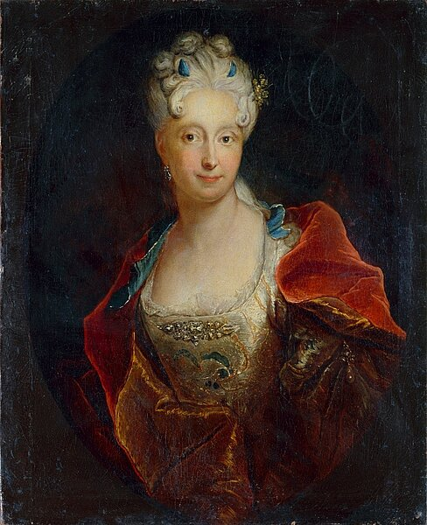
Project
Antoine Pesne, Countess Charlotte Louise of Schwerin, oil on canvas, around 1713 (Gemäldegalerie Alte Meister, Staatliche Kunstsammlungen Dresden. Photo: Elke Estel/Hans-Peter Klut

Slide 3
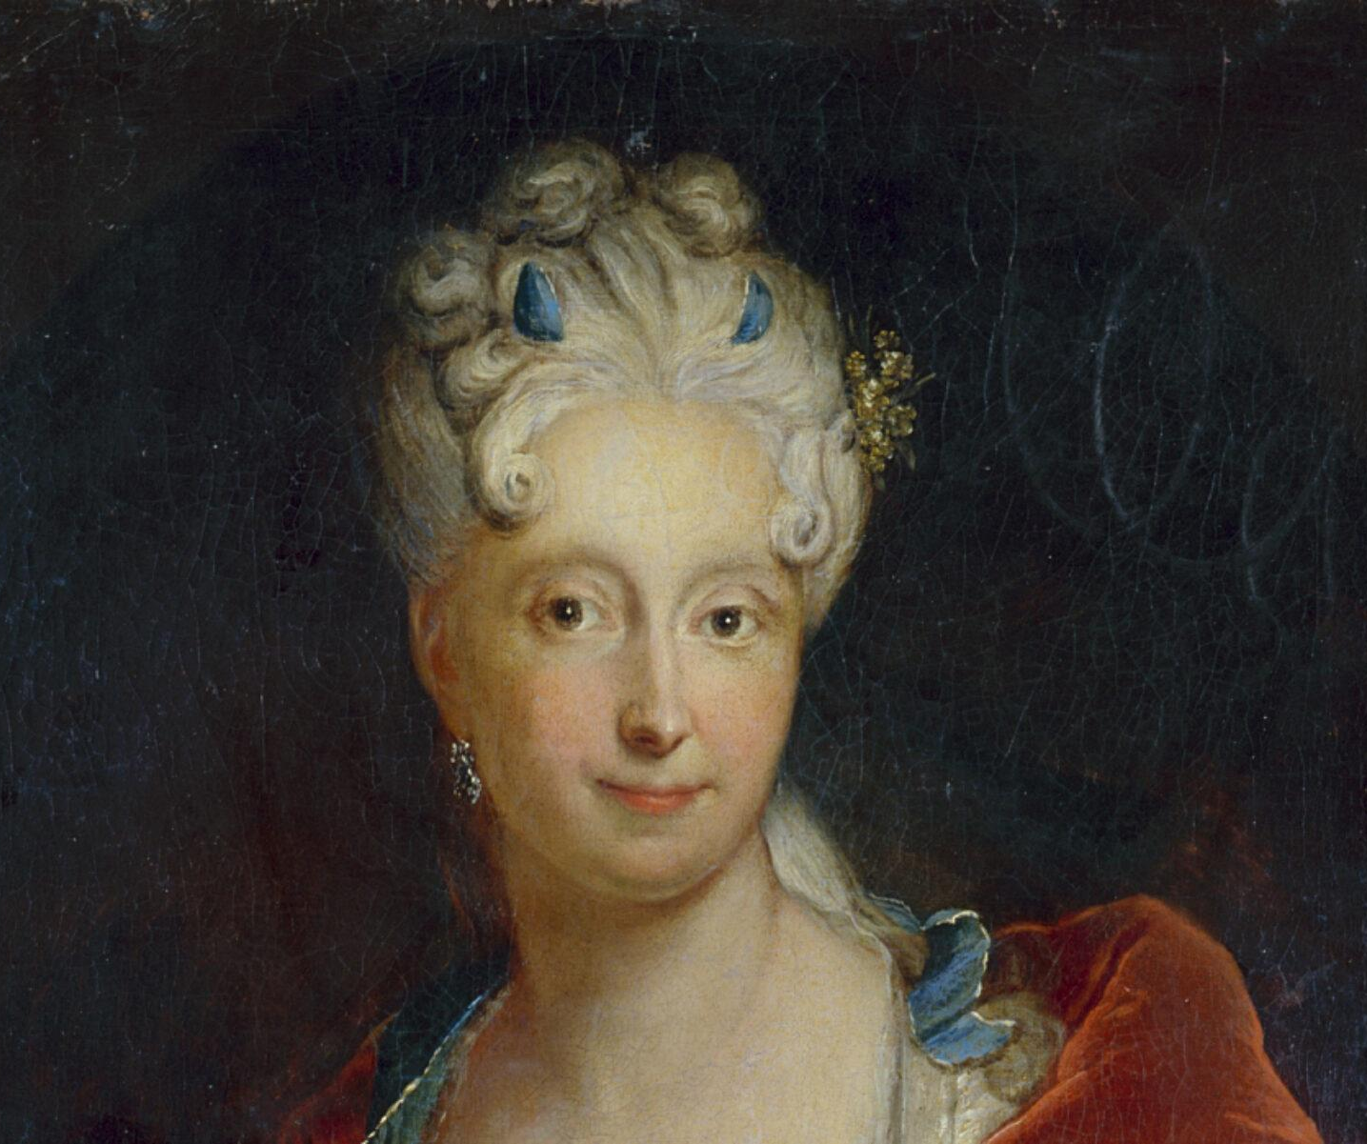
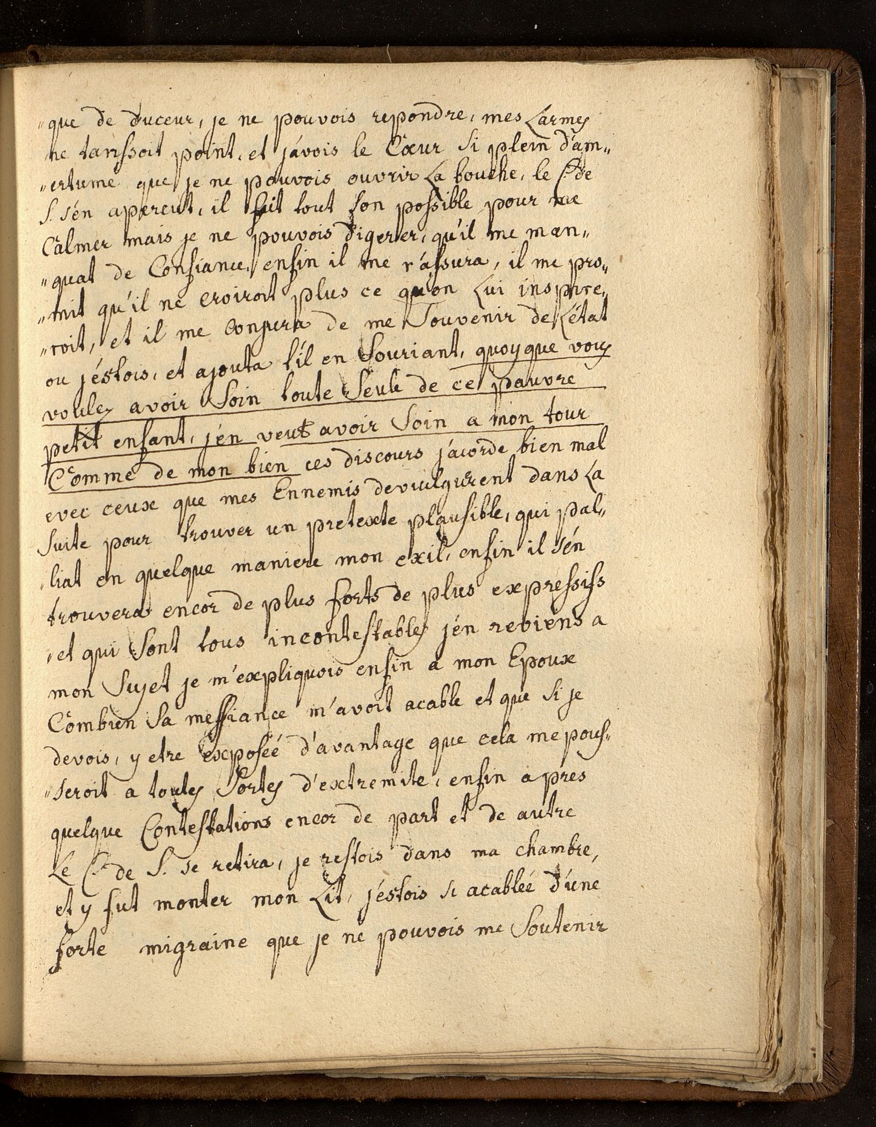

Topic
project “Tout Vienne me riait: Family and court relations in the memoirs of countess Louise Charlotte von Schwerin (1684-1732)”
FWF-funded research project, 2022-2025, implemented by the Institute for Habsburg and Balkan Studies at the ÖAW in cooperation with the Institute Center for Information Modeling (PI Ines Peper, transcription and annotation by Michael Pölzl)
project-blog: https://memoiren.hypotheses.org/

Slide 4
Sources
The Memoirs of the countess Louise Charlotte of Schwerin (born baroness of Heiden, 1684–1732) are preserved in two french manuscript copies:
manuscript A: Aix-en-Provence, Bibliothèque Méjanes, Ms 1190–1191: “L’Histoire De la Vie de madame la comtesse de Scheverin écrite par elle même a ses enfans” (vol. 1: 694 pages, vol. 2: 734 pages)
manuscript W: Vienna, ÖSTA: Haus-, Hof- und Staatsarchiv, SB Khevenhüller-Riegersburg 184/5: “Eigenhändiges Tagebuch der Gräfin Schwerin”: “Historie de la vie de Mad. la comtesse de Schwerin, ecrite par elle mème a ces enfans suivant les ordres de son Directeur à Cologne“ (630 pages)

Slide 5
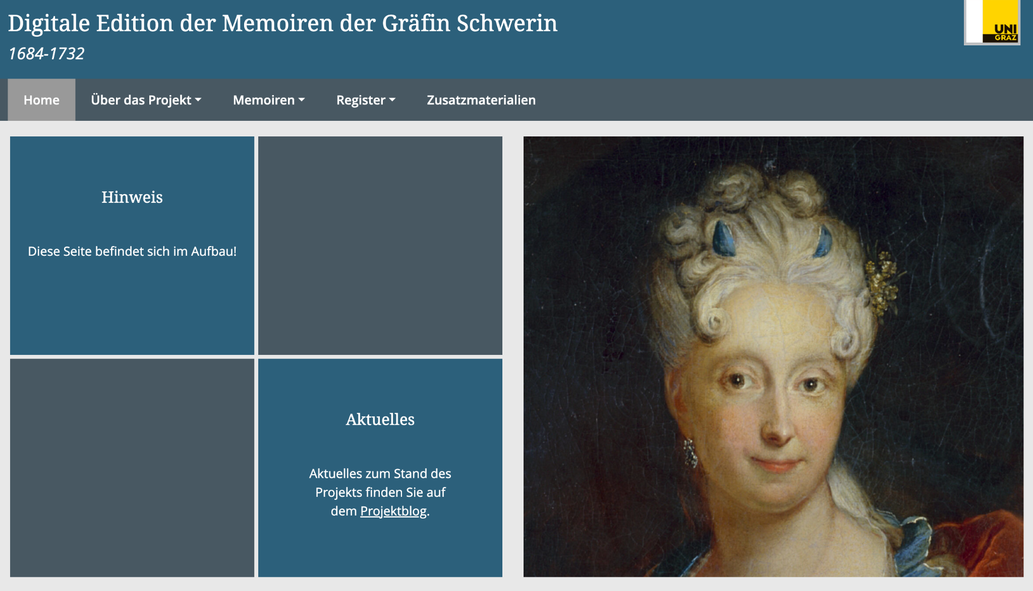
Aims of the project
Digital Edition (based on TEI/XML)
Transcription of MS W
normalized text (based on MS A and MS W)
german translation
Indices, Commentary, explanatory texts, …
Focus on modelling person relationships, network analysis
all data is archived in the long-term repository GAMS (Geisteswissenschaftliches Asset Management System) under a PID
Interface-Mockup

Slide 6
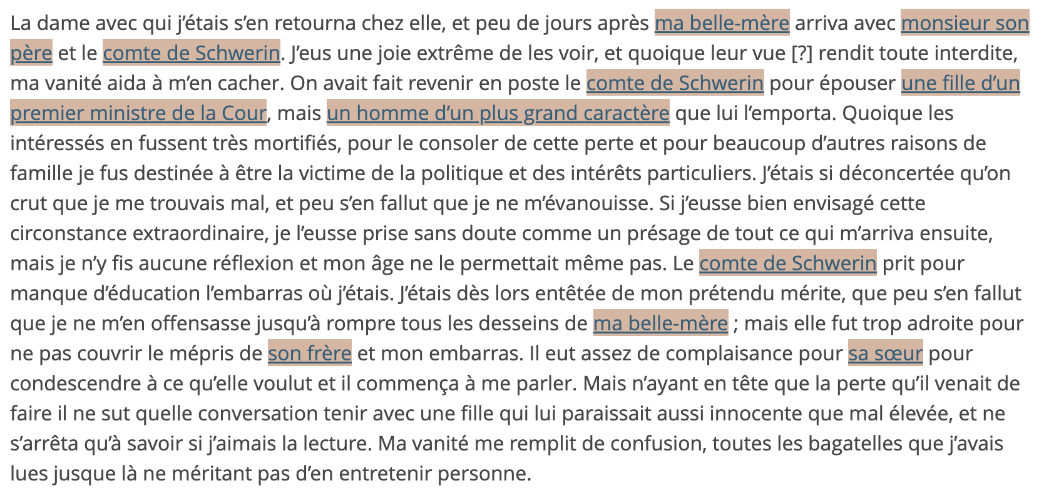
Aims of the project
research e.g. on female court networks, descriptions of the court, …
the encoding and indexing of persons and places is a main objective in digital editions, especially in the case of these text forms (like dairies, memoirs, letters)
time-consuming and detailed work
Can Named Entity Recognition help to reduce this workload?
Paragraph of the normalized text

Slide 7
Named Entity Recognition

Slide 8
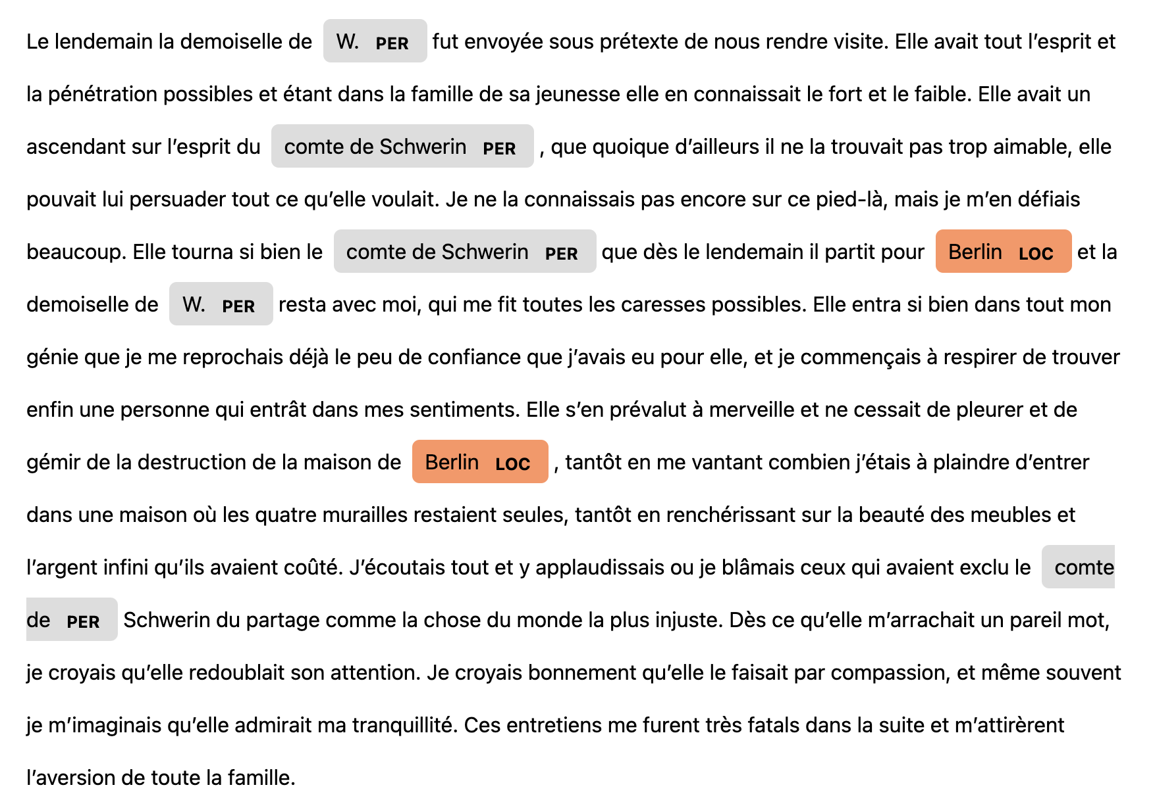
Application of pre-trained models

Slide 9


Application of pre-trained models
test with NER before the start of the annotation of named entities, to see, how good it works
short text sample from transcription, normalized text and german translation
In general: a specificity of the memoirs is the mention of persons with non-rigid designators
mon père, ma tante, mon beau-frère, mes parents, ...
Models: e.g. spaCy, flair and CamemBERT
gold standard: 183 entities (26 places, 157 persons)
human evaluation
Notes:
beau-frère = brother in law, Schwager

Slide 10
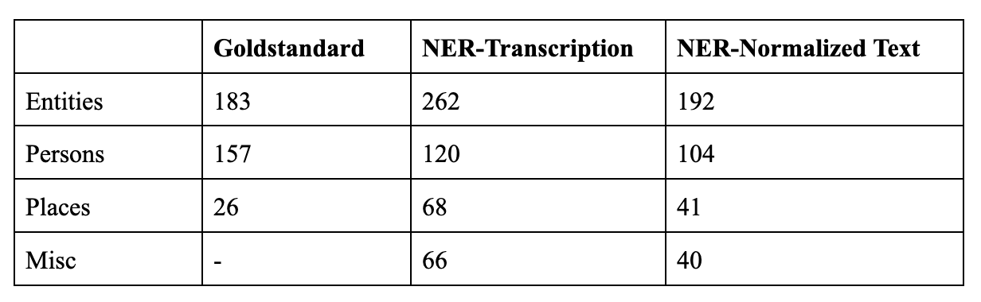
Application of pre-trained models
In normalized text, spaCy's French NER model recognizes several entities correctly, such as "Berlin" and "comte de Schwerin" but...

Slide 11
Application of pre-trained models
… only parts of entities are identified and classified, e.g. only “W.” instead of “demoiselle de W. “, or only “comte de” instead of “comte de Schwerin”)
… incorrect classification (in our case): parts of person names, like “Schwerin”, are classified as places

Slide 12
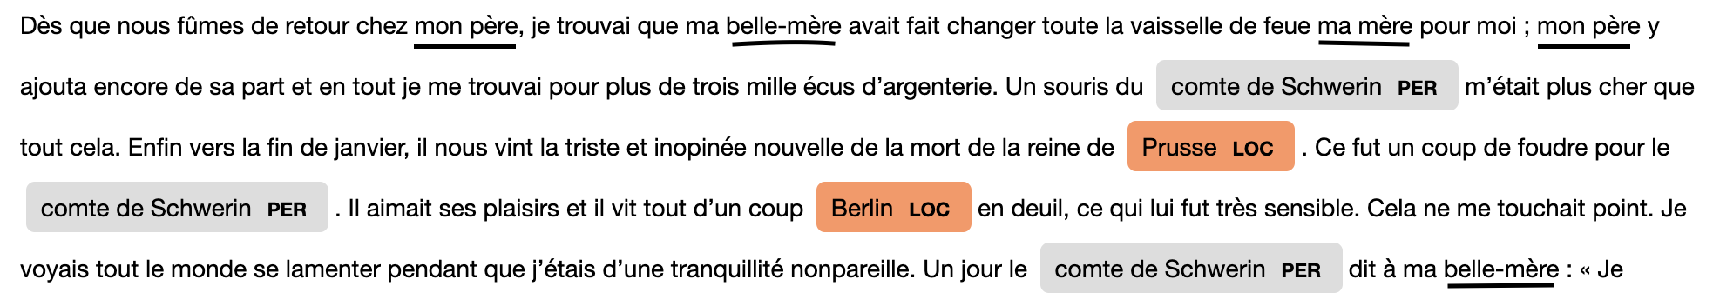
Application of pre-trained models
… missed entities!
especially these with non-rigid designators (e.g. 22x “beau-père”, spaCy-model classified 2 occurrences as “MISC”)
Notes:
belle-mere = mother in law, Schwiegermutter
beau-pere = father in law, Schwiegervater

Slide 13
Training models

Slide 14

Training a model with the french normalized text
based on Active Learning with Prodigy
based on only human annotations
in random chunks
in order
base model used: spaCy fr_core_news_md (spaCy is closely linked to Prodigy)

Slide 15
Training a model based on Active Learning

Slide 16
Prodigy: Active Learning
Experiment: Active Learning with the normalized text of the memoirs
Main questions: Does it make the annotation process faster? Does it help training a model?
Steps:
preprocessing of the text (TEI to JSONL)
plain text and text with annotations as gold standard
gold standard: 4244 tagged entities
create dataset in Prodigy with the plain text and start the recipe ner.teach = Active Learning
base model: spaCy model “fr_core_news_md”
every 200 suggestions from the model: Training of the model and evaluation to the gold standard

Slide 17
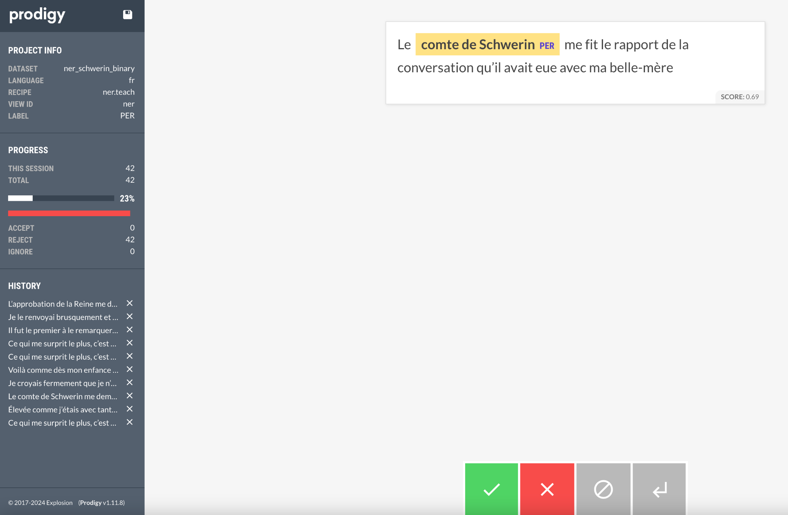

Slide 18
Prodigy: Active Learning
Impressions while annotating:
the first 100-200 suggestions - often the same suggestions:
prepositions like “m´", “d´"
“Comte de Schwerin”
200-400 suggestions:
first often suggestions where the model thinks, that no entities are contained, but in fact there are (like “ma tante”)
400-600 suggestions:
model slowly starts to consider these cases
recognizes more and more non-rigid designators
600-800
also complex names like “feld-maréchal comte de Dohna” are suggested as NE

Slide 19
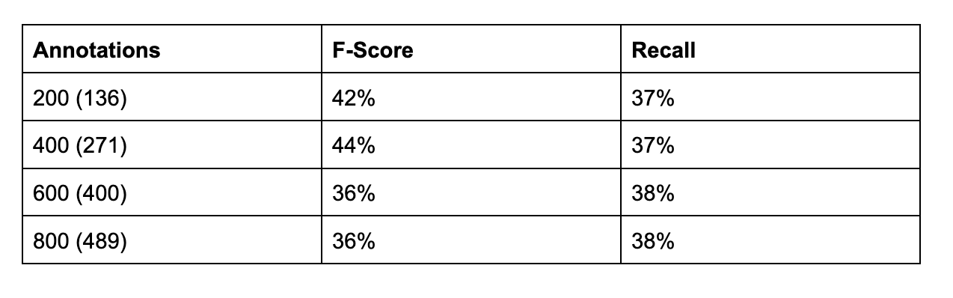
Prodigy: Training a model based on Active Learning
Test: Training a model every 200 annotations from the Active Learning Process and evaluate to the gold standard
Results from the evaluation matrix:

Slide 20
Prodigy: Training a model based on Active Learning
Why is the evaluation so bad?
Application and visualization of the model on the plain normalized text shows:
complex names are identified and labelled in general
e.g. madame de Belmont, Prince Electoral, madame la Princesse Electrice, la demoiselle de S , La comtesse Ottonette
model identifies and classifies many non-rigid designators as NE (e.g. ma tante)

Slide 21
Prodigy: Training a model based on Active Learning
BUT…
… the model also labels: ma vanité, ma vie, ma grande, ma douzième, ma correspondance, ma lettre, ma folie, ma curiosité, …
… the model also labels e.g. “le comte de Schwerin” with the article → in the gold standard its only tagged as “comte de Schwerin”
it's also inconsistent in the gold standard (rules were not well defined, 2 different annotators)

Slide 22
Training a model based on human annotations

Slide 23
Training a model based on human annotations
Second experiment: train a model based on human annotations
Steps:
extract 200 random sentences with annotations from the gold standard
import in prodigy as a dataset
train a model with the dataset and evaluate it to the gold standard
repeat this with 400, 600 and 800 random sentences with annotations
and: do the same, but with the right order of the sentences (imitate human annotating)

Slide 24
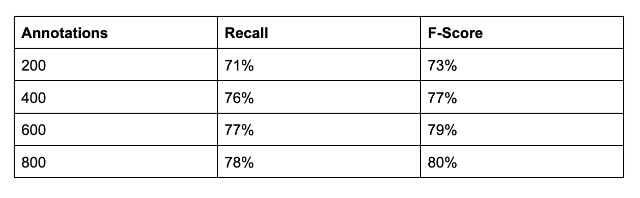
Mimicking the Human: Training a model based on human annotations in original sequence
Evaluation of the model trained with sentences in order:

Slide 25
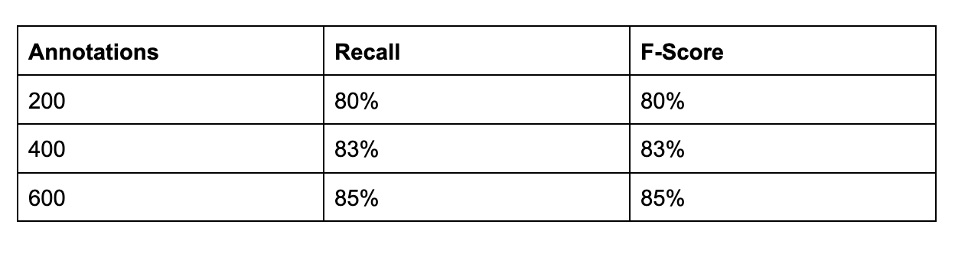
Not mimicking the Human: Training a model based on human annotations randomly selected
Evaluation of the model trained with random sentences:

Slide 26
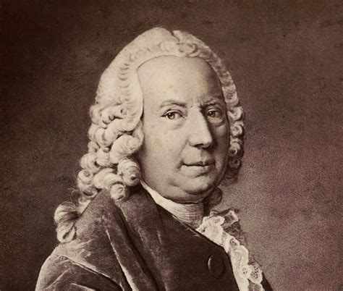
Transferability? Application of fine-tuned model

Slide 27
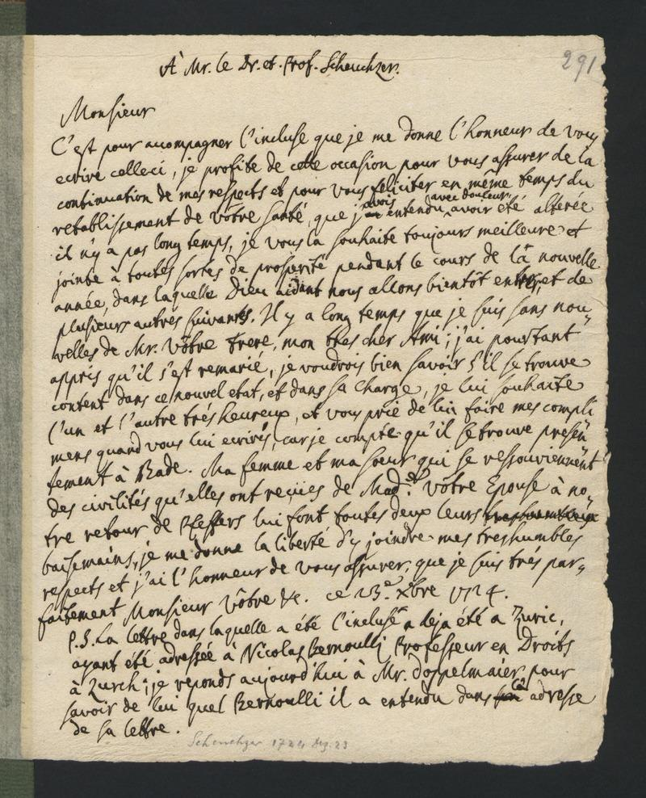
Application of a fine-tuned model on similar texts
application of a fine-tuned model from the memoirs on a similar text
e.g. Basler Edition der Bernoulli-Briefwechsel
Letters from Bernoulli
french
ego-documents
early 18th century
Test with one letter
Bernoulli, Nicolaus to Scheuchzer, Johann Jakob, 1724.12.23

Slide 28
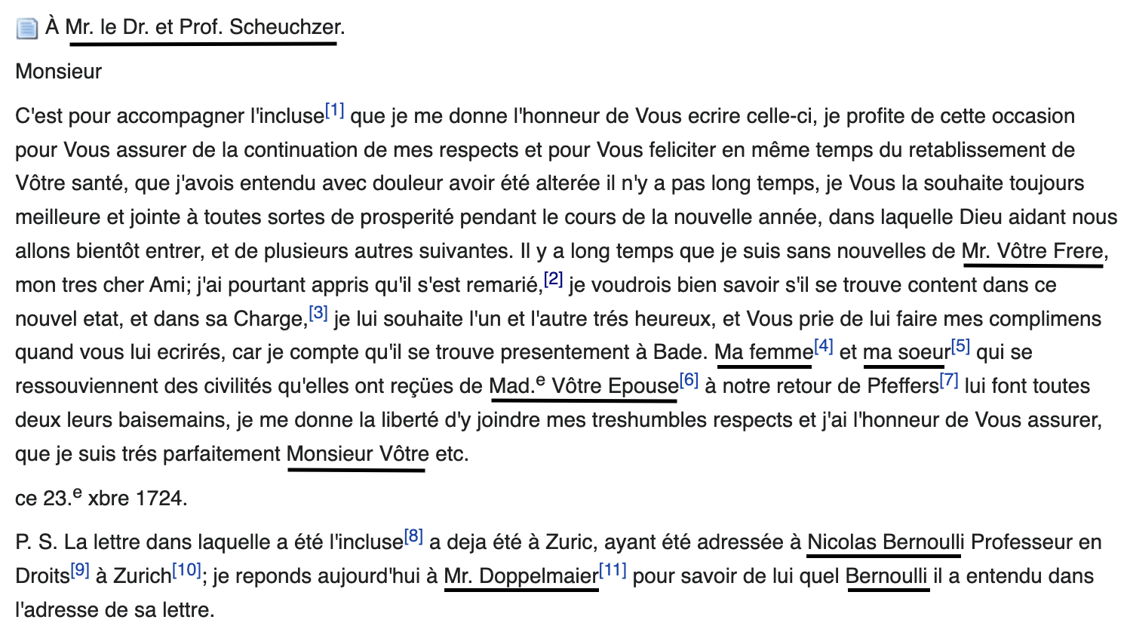

Slide 29
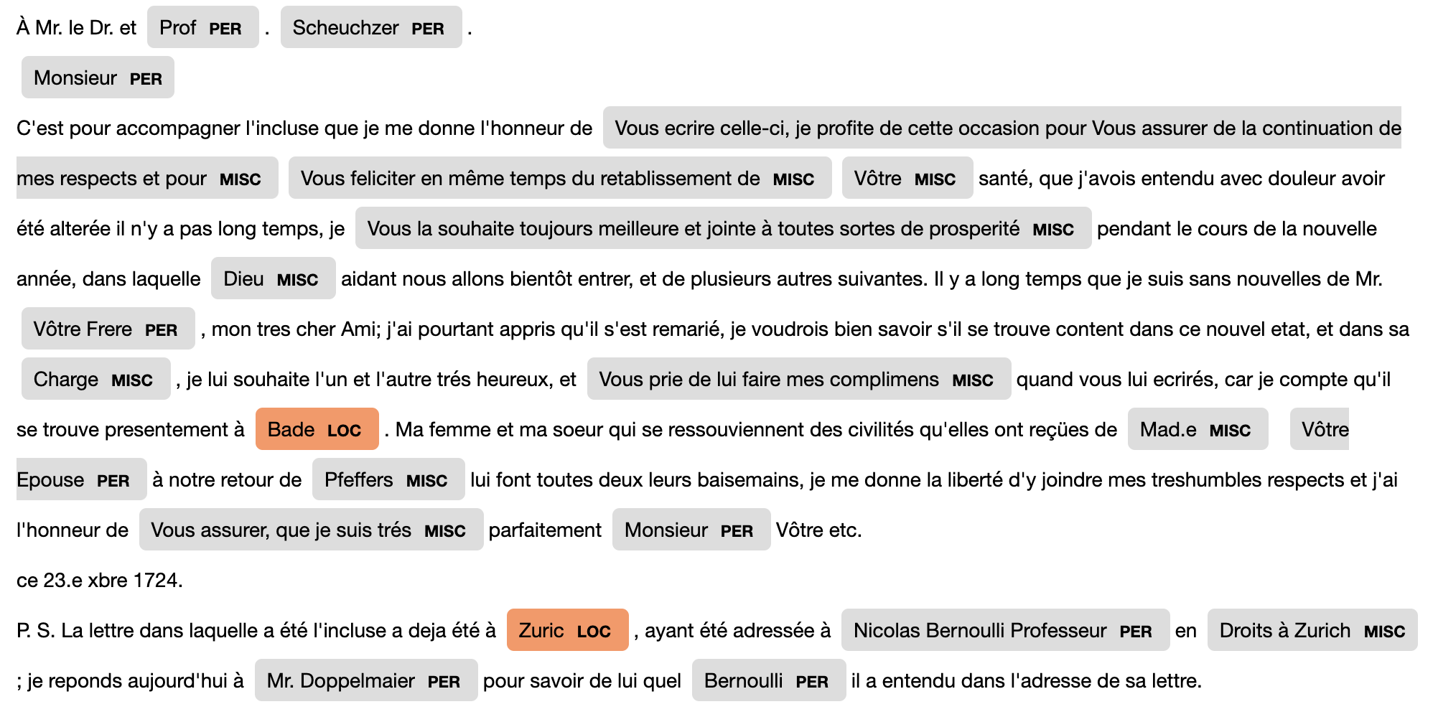
Application of generic spaCy model fr_core_news_md

Slide 30
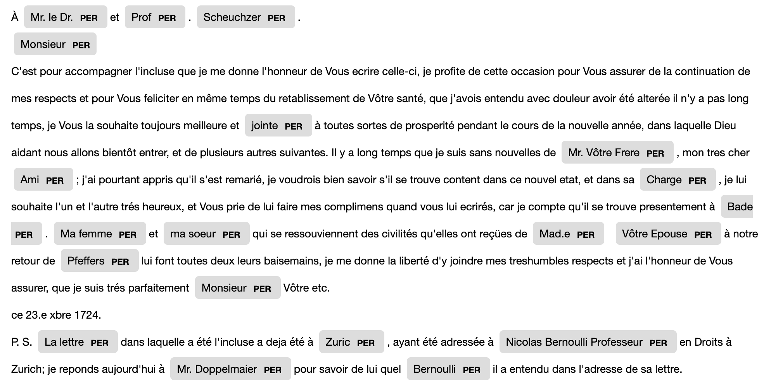
Application of fine-tuned model from Active Learning

Slide 31
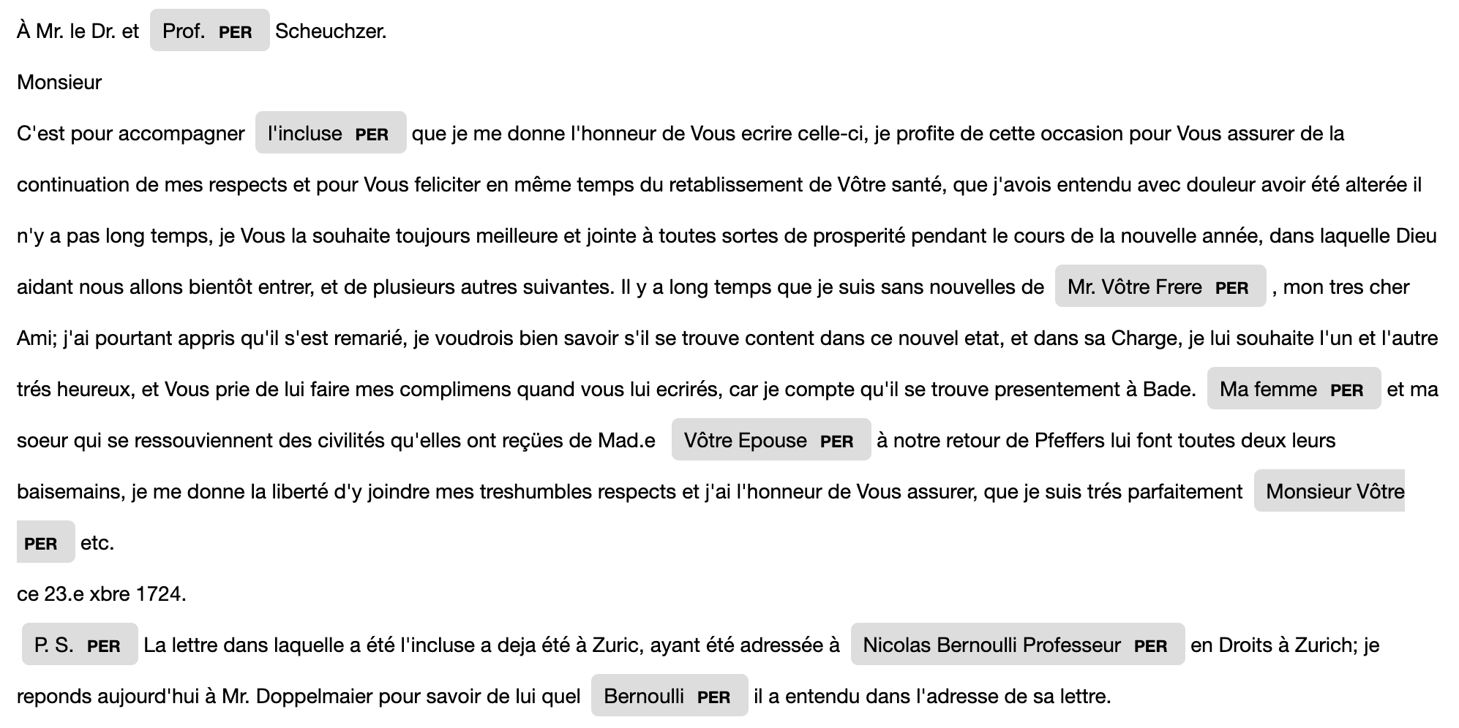
Application of fine-tuned model from human annotations

Slide 32
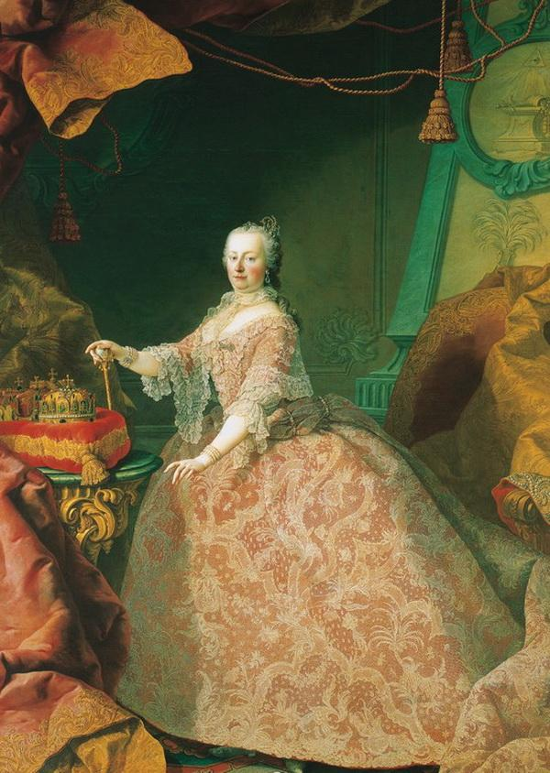
Conclusio
Gemälde von Martin van Meytens, um 1752

Slide 33
Conclusio
<rs ref="#P182" type="person">comtesse de Strattmann,
belle-sœur de mon illustre protectrice à Vienne</rs>
Performance of (trained) models is not good enough to replace human annotators
Annotators in digital editions have special interests
Active Learning: it’s easy to collect annotations very fast, but how useful are these? What do I have to know about the text before I start tagging? What implications does my tagging have?
NER-Models can be useful to get an insight into the text
Outlook:
Training complete new models?
Fine Tuning / Prompting LLMs?

Slide 34
References
Daumas, Maurice und Claudia Ulbrich (Hrsg.), unter Mitarbeit von Sebastian Kühn, Nina Mönich und Ines Peper. 2013. Mémoires de la comtesse de Schwerin. Une conversion au XVIIIe siècle. Bordeaux. Saul Kripke: Naming and Necessity. Harvard University Press, Cambridge 1982 Maud Ehrmann, Ahmed Hamdi, Elvys Linhares Pontes, Matteo Romanello, and Antoine Doucet. 2023. Named Entity Recognition and Classification in Historical Documents: A Survey. ACM Comput. Surv. 56, 2, Article 27 (February 2024), 47 pages. https://doi.org/10.1145/3604931 flair. Aufgerufen am 12. Juli 2023. https://github.com/flairNLP/flair. Martin, Louis; Muller, Benjamin und Pedro Javier Ortiz Suárez et al. 2020. “CamemBERT: a Tasty French Language Model.” In Proceedings of the 58th Annual Meeting of the Association for Computational Linguistics: 7203–7219. More, Jacqueline. 2021. “Theorie und Anwendung von Named Entity Recognition in den Digital Humanities mit Fokus auf historische Texte des 17. Jahrhunderts.” Masterarbeit, Universität Graz, http://unipub.uni-graz.at/obvugrhs/6203623. spaCy. Aufgerufen am 19. Juni 2023. https://spacy.io/. prodigy. Aufgerufen am 12. Juli 2023. https://prodi.gy/docs.

